Slide 1
Winston Downs Community Association/WDCA
Public Meeting November 14, 2023
Topic: Zoning Changes

Slide 2
Two Possible Changes
ADU at 6750 E. Exposition
Vacant lot at 6550 E Dakota Ave
(Lot was formerly 400 S Monaco Pkwy)

Slide 3
Property located at 6750 E. Exposition seeks zoning change
History overview and comments from homeowner

Slide 4
6750 E. Exposition Ave.
House addition was completed in 2020. The Residential Plan Review Supervisor confirmed 6750 Exposition Ave as a Single Dwelling Unit, w/ complete second kitchen, per 2010 DZC.
The BOA granted a variance and stamped, approved the plan set for an Attached Garage forward of Primary Front Façade and a 2nd Story primary street setback encroachment.
The plan set also included the modifications for Single Dwelling Unit, w/ complete second kitchen, overall height modification and electric vehicle charger which complied with DZC.
The home has been used as a short term rental
Currently, the home is seeking zoning change to ADU.
Notes:
The permit record 2020-sudp-0003075 indicates a change of use from Single Family Dwelling to Duplex.
Ben asked that this note in slide be eliminated.

Slide 5
Emailed comments from CW Amanda Sawyer
“Any homeowner in Denver can apply to rezone their individual property to allow for an ADU, and this property owner is doing that. It seems they are attempting to come into compliance with the zoning code since they already built the structure.
Additionally, any homeowner can use their home as a short term rental/STR whether they have an accessory dwelling unit or not - as long as they are licensed through our department of Excise and Licenses.
The history. The NIS inspectors who took a look at the property said that the presence of an internal door that separated the addition from the other living space is what made the new space an ADU instead of a home addition.
The homeowner removed the door and that is how they came into compliance with the zoning code previously.
I believe the homeowner would like to put the door back up to separate their short term rental space from the rest of the home. Putting the door back up would technically make the addition space an ADU under our zoning code – and they don’t have the zoning for that – which is why they would like to rezone.”

Slide 6
Pros / Cons for ADU
Questions
Concerns
Comments

Slide 7
KBY Property 6550 E Dakota Ave
Property to become an Orthodox Synagogue

Slide 8
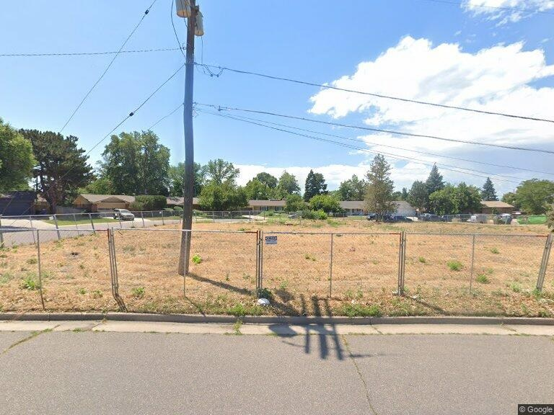
6550 E Dakota Ave today

Slide 9
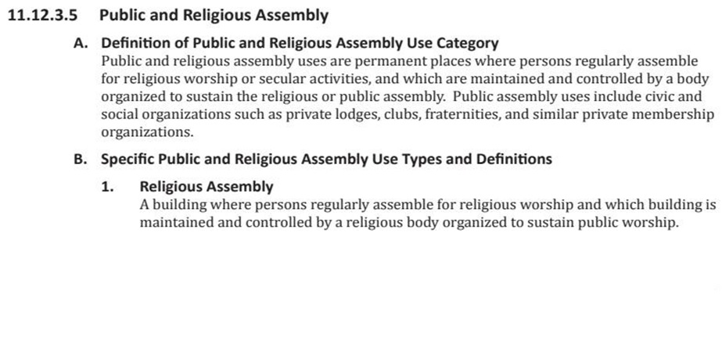
Reminder of the zoning code

Slide 10
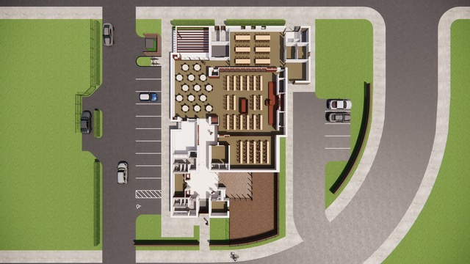
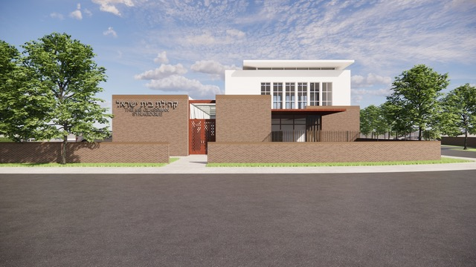
Structure concepts

Slide 11
Key Points
Renting now at 295 S Locust (Locust/Alameda)
Need more space for growth and activities
Currently have 55 FAMILIES and “about” 15 children = 125 people or more
80% (40) families are reported to live in Winston Downs
Will offer indoor/outdoor children’s areas
Has 16 parking spaces on the property
Will accommodate special events such as weddings, etc.

Slide 12
Concerns
Safety Factors
Increased traffic on Dakota since driving is permitted during the week.
Increased pedestrian traffic, especially at high holy days
Street Parking
Congregants do not drive on the Sabbath but may drive during the week to services, events.
Congregants may drive until sundown on Friday and leave parked vehicles overnight until Sabbath services are over
Parking will impact E Dakota, E Alaska, Newport and Nevada Ave

Slide 13
Concerns
Driveway easement in place with 402 S Monaco Pkwy & 440 S Monaco Pkwy
Change of use from Single Family to Religious Use
Lot size 9,220SF and zoned as S-SU-F. This property is currently for three (3) homes.
Changes the stated zoning characteristics of Winston Downs
Reduces number of single family properties in Winston Downs
If building discontinues “religious use”, it can potentially become another non-residential use.

Slide 14
Pros/Cons
Questions
Comments
Concerns

Slide 15
Addendum-Things to consider
Euclidian zoning to Form Base done in last Zoning Code updates
Euclidean zoning is a type of zoning that only allows one kind of land use per zone
Lot size 9,220 and zoned as S-SU-F
ADU’s are permitted in the Near SE Area Plan – requires Zoning Change
Any property can use their home for STR- requires City license
Duplex’s permitted as long as attached to existing structure.

