Slide 1
Exposition Avenue Traffic Calming Meeting
February 27th, 2024 – 6:00 PM

Slide 2
Agenda
Project background & process
What is traffic calming?
Survey launch
Community discussion

Slide 3
Background
Council District 5 has received concerns from constituents regarding the difficulty traveling and perceived safety issues along Exposition Avenue and at the Monaco Parkway/ Leetsdale Drive intersection (including speeding, cut-through traffic, and challenges walking and biking).
Council District 5 has hired an engineering consultant to assist us in analyzing travel patterns and traffic calming strategies, along with the input from a working group of local neighborhood leaders.

Slide 4
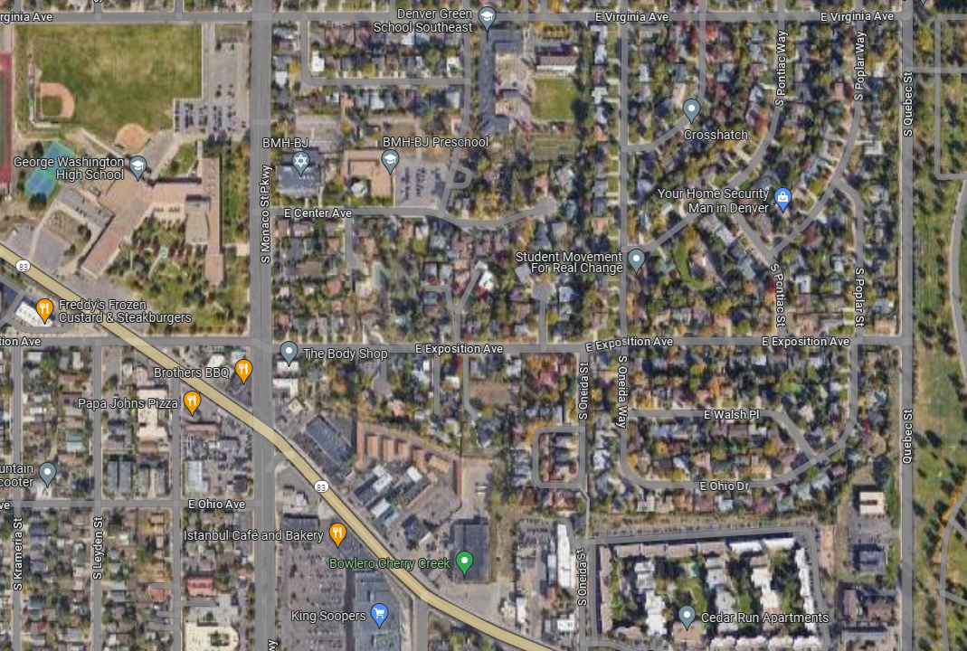
Study Area
Exposition Avenue from Leetsdale Drive to Quebec Street
Monaco Parkway & Leetsdale Drive intersection

Slide 5
Working Group Members
Councilwoman Amanda Sawyer
Owen Brigner, Councilwoman Sawyer’s Office
Logan Fry, Councilwoman Sawyer’s Office
Nicole Aviles, Councilwoman Sawyer’s Office
Juan Sipion, Councilwoman Sawyer’s Office
Molly Lanphier, Denver’s Department of Transportation & Infrastructure
Charles Alexander, Fehr & Peers
Sydney Provan, Fehr & Peers
Jane Lorimer, Winston Downs Community Association
Mickey Greenberg, Winston Downs Community Association
Carrie Olson, DPS Board of Education District 3
Lindsey Levin-Salamon, BMH-BJ Preschool
Dackri Davis, George Washington High School
Jose Piza, Denver Green School
Jessica Krichbaum, Denver Green School
Prudence Daniels, Denver Green School
Kelly Briggs, Fairmount Cemetery
Joe Levi, DOTI Advisory Board Member for D5
Jace Davis, Bicycle Colorado

Slide 6
Study Process
Phase I (February – March 2024)
Phase II (April – May 2024)
Phase III (June – August 2024)
Survey & Community Listening
Observations, Data Collection, & Analysis
Conceptual Design & Cost Estimates
1 public community meeting per phase.

Slide 7
What is Traffic Calming?
Infrastructure and programs to encourage responsible driving, reduce traffic speeds, and control traffic volumes.
Goal is to ensure our roadways are safe and comfortable for everyone.
Traffic calming measures fit into one of three categories, referred to as the three "Es”.

Slide 8
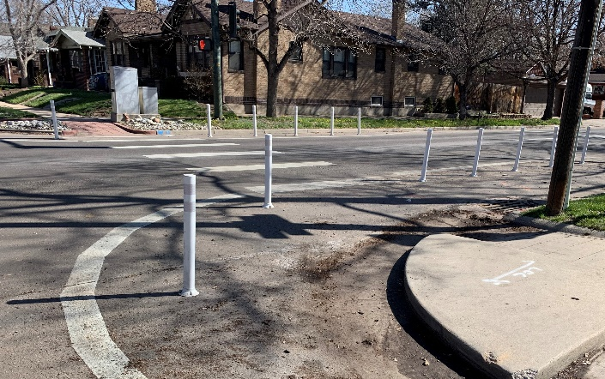
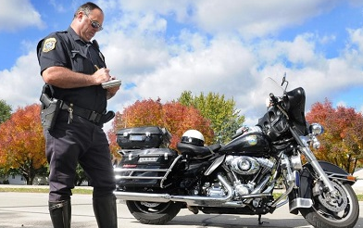
What is traffic calming?
Engineering (DOTI)
Education
Enforcement
Only E that DOTI influences.
Infrastructure changes that encourage drivers to slow down or use different streets.
Generally community led.
Educate and encourage roadway users to respect safety and the experience of other roadway users.
Police Department Neighborhood Enforcement team is the front line.
Effective but must be frequent.
Notes:
The most effective traffic calming efforts entail measures from all 3 E’s; All traffic control treatments have varying levels of effectiveness, maintenance costs, and downsides.

Slide 9
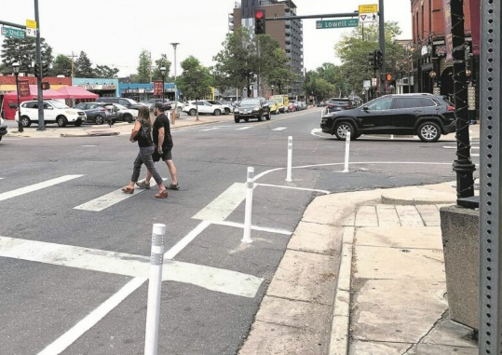
What types of traffic calming improvements might be identified?
Curb Extension/Bulbout
Painted curb extensions/bulb-outs
Painted pedestrian refuge islands
Crossing markings
Signage
Flashing beacons
Street lighting
Movement restrictions or diverters
Pedestrian Refuge Island

Slide 10
Previous District 5 Traffic Calming Projects:
8th Avenue
6th Avenue
Dayton Street
Uinta Way
Implemented improvements at 8th Avenue & Dexter Street intersection

Slide 11
Is there funding for construction?
Not currently. This study will identify how much improvements may cost so that a funding source can be identified.
DOTI may be able to construct some low-cost projects in 2025.

Slide 12
Survey
bit.ly/ExpostionAveSurvey
Will distribute via, postcards, RNOs, Facebook, and flyers.
Questions are regarding existing transportation challenges in the study area (e.g. crossing locations, vehicles speeds, etc.)
Last day of survey: Friday, March 31st

Slide 13
Topics for Community Discussion
Where and what types of unsafe behaviors do you observe in the study area? (e.g. speeding, running stop signs, cut-through traffic)
What challenges do you currently experience walking or biking in the study area?
At what intersections do most people cross the street in the study area?
What specific locations are challenging or feel unsafe for people walking and biking in the study area?
Where in the study area is it challenging for drivers and people walking and biking to see each other?
What other concerns do you have regarding transportation in the study area?

Slide 14
Questions & Community Discussion

Slide 15
Follow Up & Next Steps
Fill out the survey at bit.ly/ExpostionAveSurvey by March 31st.
Fehr & Peers will study intersections based on survey results, crash analysis and field observations.
Second community meeting May 21st, 2024 to review data analysis results.
Based on results, DOTI will evaluate traffic study to determine if treatments are warranted and will begin to identify funding sources for implementation.

Slide 16
Thank you!
Survey Link: bit.ly/ExpostionAveSurvey
Councilwoman Amanda Sawyer Denver Council District 5 DenverCouncil5@denvergov.org 720-337-5555
Fehr & Peers Sydney Provan Sydney.provan@gmail.com

