Slide 1
Winston Downs Community Association
WDCA Annual Meeting April 2024 Please sign in!

Slide 2
Agenda
Welcome and Introductions
WDCA – Overview, projects, help needed
Treasurer/Membership Report
Safety Updates
Special Topic – Urban Oil Drilling Update
CW Amanda Sawyer Updates & Q/A!
Board Elections
As always our sincere thanks to BMH-BJ Synagogue for being our partner for these public meetings

Slide 3
Overview - Who We Are
WDCA is a Registered Neighborhood Organization (RNO) with the City & County of Denver
-Participation & membership are voluntary
-We are not an HOA
-All residents are welcome to all published meetings
-All residents may sign up to receive eNews
WDCA is also a proud member of the Inter-Neighborhood Cooperation/Denver INC -a coalition of Denver’s RNO’s

Slide 4
Our Purpose
To empower & encourage residents to work together to achieve common neighborhood goals
To promote and foster a sense of unity and caring among people in the neighborhood
To ensure Winston Downs has a voice and representation on city issues

Slide 5
WDCA Board 2023-24
President - Jane Lorimer
Vice President - Jeff Aldrich
Secretary/Past President -Tim Rooney
Treasurer - Joanna Milewski
Director - Susan Bernard-Gross
Director - JoNell Herndon
Director - Danielle Taro
Notes:
Introduce all board and past presidents who attend

Slide 6
WDCA Chairs
Beautification/Clean Up -Tim Rooney, Linda Peters
Membership Development - Susan Benard-Gross, Danielle Taro
News Delivery Team - Jan Hoskins
Poplar St Coalition - Marla Titkin
Safety Committee - Mickey Greenberg
Welcome Committee - Susan Bernard-Gross

Slide 7
WDCA Neighborhood Representatives
Near SE Area Plan Steering Committee - Harvey Cohen
Denver INC Delegates - Dave Halterman, JoNell Herndon
E. Exposition Traffic Study Panelists - Mickey Greenberg, Debbie Costin
KBY Synagogue Building Project Liaison - Dan Levin

Slide 8
Yes, It Takes a Village!
Please visit our sign up sheets on back wall
Committee participation is open to all residents
Where we need help:
WordPress web posting
Block party help
News delivery people
Clean up volunteers
MailChimp Enews
Social event hosts

Slide 9
Current Projects
Developing better relations with DGS with support from DPS District 3
Participating in E. Exposition Traffic Study and interior traffic calming
Hosting Annual Safety Meeting- May 15
Monitoring zoning and road changes
Addressing neighborhood concerns

Slide 10
Continuing Projects
Continued news, communications
Safety – WD Representation, updates
Social events designed to build unity and support for one another
Membership development
Neighborhood cleanup
Working in partnership with Council District 5
Notes:
Concerns such as parking allowances in bike lanes for home health care workers & bike lanes on Monaco

Slide 11
Treasurer’s Report Joanna Milewski, WDCA Treasurer
Treasury as of 3/31/24
Checking = $4010.10, Savings = $7018.16
Total: $11,028.26
Membership as of 4/14/24
120 Members = 22% of total occupied households
Total revenues from dues $2334.37
52 (44%) gifted above dues amount
31 (26%) paid online (Paypal)
Notes:
Joanna up to 10 minutes

Slide 12
What Dues Pay For
Annual Block Party (Food/supplies)
Association costs (Bank, post office box, etc.)
Beautification/Clean up supplies
Door to door printed news/announcements
Online communications (Zoom, eNews, Website)
Public meetings (Venues, supplies)
Signs, banners for special events
Thank you to Council District 5 for covering meeting door hangers this time!
Notes:
Thank you to District 5 for paying for the door hangers related to this meeting and the Annual Safety Meeting
Thank you to Auto Body for sponsoring upcoming Spring weed cutting and spraying we do on Monaco and Quebec

Slide 13
Safety – Mickey Greenberg
WDCA Annual Safety Meeting Wednesday, May 15 - 7:00PM BMH-BJ Synagogue
Agenda
DPD Staff Introductions & Q/A
911 Call Center & Q/A
Specific questions, concerns: Send to Mickey at Arthur.m.Greenberg@gmail.com
Notes:
Mickey – five minutes max

Slide 14
Special Topic
Urban Oil Drilling
Jeff Aldrich, WDCA VP
Notes:
Jeff – 5 minutes max

Slide 15
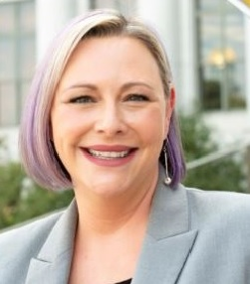
Updates & Q/A Councilwoman Amanda Sawyer-District 5
Council District 5 Staff
Owen Brigner, Sr. Council Aide
Nicole Aviles, Council Aide
Juan Sipion, Council Aide
Notes:
We are honored to have District 5 CW Sawyer with us tonite. She has been asked to address Lowry Vista development, sidewalk fee status, Area Plan status, Compost barrel delivery status and fill in traffic study on Expo if we don’t get it fully described
We must watch time to permit 20 minutes for elections.

Slide 16
2023 District 5 Year in Review
Winston Downs Community Association Annual Meeting
April 16, 2024
DENVER DISTRICT 5 ★ CONNECTING PEOPLE & GOVERNMENT

Slide 17
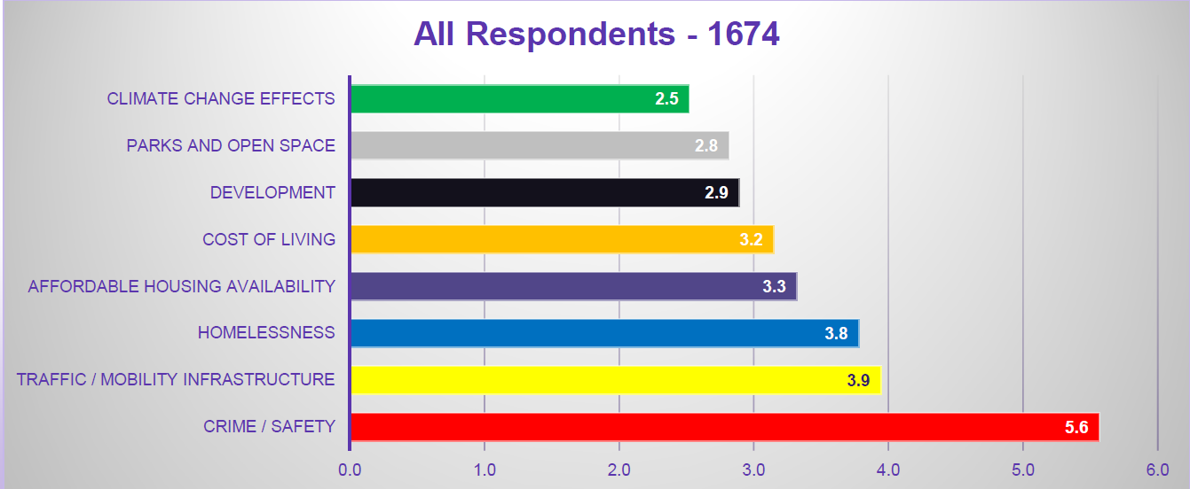
Annual 2023-2024 Year in Review
2023 Most Important Issues to District 5 Residents
Councilwoman Amanda Sawyer ★ Denver District 5

Slide 18
2022-2023 District 5 Highlights
Chairing charter review committee to discuss ways to modernize Denver’s Charter
Passed groundbreaking wage theft legislation that makes Denver workers the most protected in the nation
Supported the creation of an eviction clinic within the Denver County Courts that has served over 800 Denver families in 2023
Sponsored legislation to apply the Active Centers and Corridors (DO-8) design standards to properties along East Colfax which will promote walkability and small business growth
Sponsored legislation to allow the Auditor’s Office to better oversee and update Denver’s prevailing wage pay classifications
Facilitated a conversation about rezoning Montclair to allow for ADUs (there was not clear support from residents for the proposal, so this will not move forward)
Partnered with DPD to do a lighting and crime study of every neighborhood in District 5, to identify opportunities to enhance community safety
Completed a traffic study of Uinta Way from 11th Ave to Lowry Blvd to enhance traffic safety in East Denver
Councilwoman Amanda Sawyer ★ Denver District 5

Slide 19
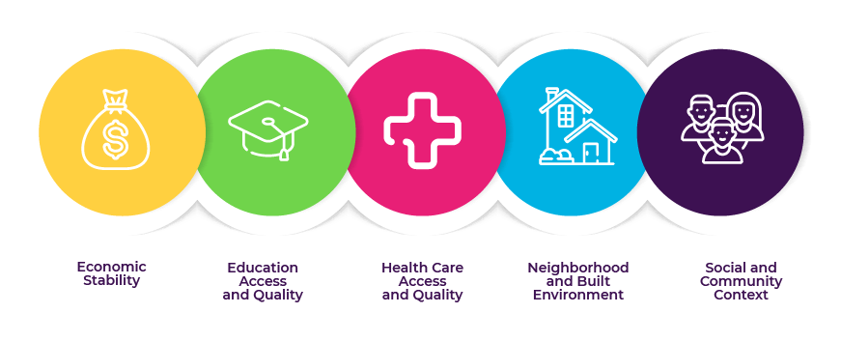
Our Lens: Social Determinants of Health
Councilwoman Amanda Sawyer ★ Denver District 5

Slide 20
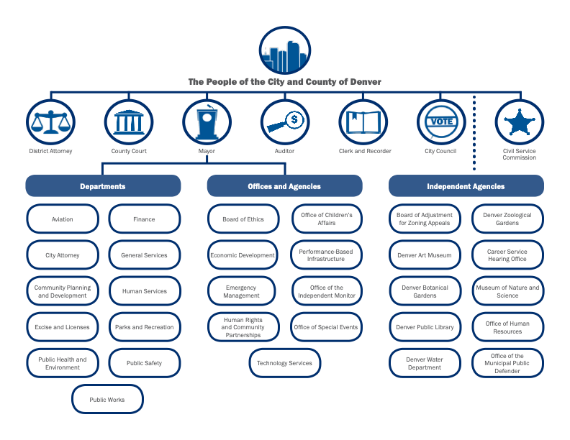
D5’s Community Safety Work with Agency Partners
Councilwoman Amanda Sawyer ★ Denver District 5

Slide 21
2022-2023 Community Safety Improvements
Working with HOA’s to assess feasibility of installation of HALO cameras in strategic areas within District 5 neighborhoods
Provided additional funding through the BIO Fund for Denver businesses to add safety and security measures
Supported new legislation to crack down on inoperable, inappropriately-stored, and abandoned vehicles in the Right-of-Way
Distributed lightbulbs to every single-family residence in the Hale and Montclair neighborhoods
DPD created a free auto theft prevention program called DenverTrack. By registering, vehicle owners give DPD permission to utilize tracking technologies to thwart would-be thieves and work to recover your vehicle if it’s stolen
DPD created a bicycle registration via 529 Garage that has shown an almost 50% reduction in bicycle theft in other cities
Councilwoman Amanda Sawyer ★ Denver District 5

Slide 22
DenverTrack and Project 529 Garage
DPD created a free auto theft prevention program called DenverTrack
By registering, owners give DPD permission to utilize tracking technologies to thwart would-be thieves and work to recover your vehicle if it’s stolen
Register and learn more at: denvergov.org/denvertrack
DPD partnered with Project 529 Garage for a similar crime prevention effort for bicycles
Register and learn more at: https://project529.com/garage
Councilwoman Amanda Sawyer ★ Denver District 5

Slide 23
2022-2023 Traffic Safety Improvements
Funded a traffic study of Uinta Way from 11th Ave to Lowry Blvd to enhance road safety in East Denver. Learn more at: https://bit.ly/CD5Projects
Installed an RRFB flashing crosswalk at 6th Ave and Clermont
Construction has started on the bikeway on 12th Ave from Colorado Blvd to Yosemite St. Learn more at: https://bit.ly/DenverMovesBicycles
Successfully overrode a mayoral veto to fund the design and installation of one RRFB flashing crosswalk in every Council district
Successfully advocated for $800,000 in funding for the design phase of one stoplight in each Council district
Councilwoman Amanda Sawyer ★ Denver District 5

Slide 24
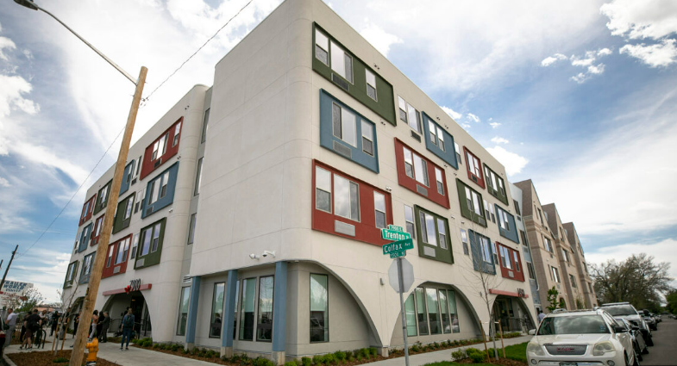
2022-2023 Housing & Homelessness Improvements
Opposed making SOS sites permanent in the zoning code because the goal should be permanent housing
Supported HOST in the creation of the Housing Prioritization policy to offer residents who have been displaced an opportunity to return to their community
Opened 72 units of housing for 0-30% AMI residents with Traumatic brain injuries in East Colfax
2,498 affordable units in development across the city
645 affordable units preserved across the city
View the dashboard at https://bit.ly/HOSTDashboard
Councilwoman Amanda Sawyer ★ Denver District 5

Slide 25
Councilwoman Amanda Sawyer ★ Denver District 5

Slide 26
What’s Happening Around Rangeview?
Sidewalk Fee Status
Fee collection has been delayed by City Council until July
Sidewalk Working Group has issued three recommendations related to the fee structure, discounts, and timeline of implementation
Learn more about the recommendations here: denvergov.org/sidewalks
Near Southeast Area Plan (NSEAP)
Entering the implementation phase of the NSEAP
Please join us for a community open house on April 23 from 5:30 – 7 P.M. at Place Bridge Academy (7125 Cherry Creek N Dr, Denver, CO 80224)
Learn more about the NSEAP at denvergov.org/NearSoutheastPlan
Trash, Recycling, and Compost
Exposition Traffic Study
Council District 5, which is considered trash district 7, is scheduled to have compost bins delivered in 2025
Learn more about the phased rollout here: denvergov.org/compost
Councilmember Sawyer is facilitating a traffic study of Exposition Ave from Quebec St to Leetsdale Dr, including the Monaco triangle
Please register for the virtual May 21st community meeting at 6:00 p.m. here: Bit.ly/ExpositionStudyMay
A community was held on February 27. Watch that meeting here: Bit.ly/CD5Projects
Councilwoman Amanda Sawyer ★ Denver District 5 | 26

Slide 27
How Can You Help?
Make sure the City knows about the issue!
Report to 3-1-1 and DenverCouncil5@denvergov.org
Call 911 when you witness a crime in progress
Get to Know Your Neighbors & Support Our Community!
Bring in their packages or trash cans to stop crimes of opportunity
Keep your garage doors closed
Join your HOA, neighborhood organization, or school PTA
Light up the Neighborhood at night!
Keep your porch and alley lights on at night to deter crime
Contact our office to request additional street lights from Xcel
Please Slow Down!
Stop at stop signs
Don’t text and drive
Share the road with pets, kiddos, and bikers
Grab a “SLOW DOWN” yard sign to remind other drivers
Keep an Eye Out for Each Other!
Take the DPD Neighborhood Watch Training and start a Neighborhood Watch program on your block
Request a free CPTED study of your home or business
Get a Ring Doorbell and/or cameras installed
Register your vehicle with DenverTRACK
Get a free Club from DPD if you have one of the top 10 most stolen vehicles
Councilwoman Amanda Sawyer ★ Denver District 5

Slide 28
Reporting Information
When to call 911:
To report a crime in progress
To report a fire
To save a life
When to call 311:
To report issues related to municipal services, for example:
Sidewalk and road repairs
Noise complaints
Abandoned vehicles
Large debris blocking roadways
Trash issues or garbage bin replacements
Dangerous animal complaints
Damaged traffic signals or road signs
Graffiti removal
Leaking hydrant or sewer problems
When to call Police Non-Emergency:
Any crime to a person not life-threatening
Burglary to a home not in progress
Auto theft not in progress
After hours parking complaints
After hours loud music complaints
Did you Know You can File a Police Report Online?
For non-emergency crimes such as:
Damaged or lost property, vandalism
Lost or stolen checks/credit cards/ATM cards
Theft or lost property
Vandalism or theft from/to a vehicle
Right of Way Enforcement number:
720-913-1600
Police Non-Emergency number:
720-913-2000
Please always call 911 in an emergency!
Councilwoman Amanda Sawyer ★ Denver District 5 | 28

Slide 29
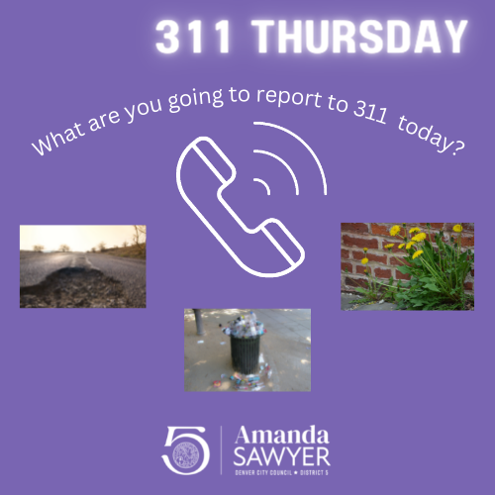
3-1-1 Thursdays!
We’re asking our residents to call in an issue, problem, or complaint every Thursday!
Not only will this help to the City to know where problems are, it will generate needed data to show how the City can best allocate its resources to make our neighborhoods safer!
Call 3-1-1 to help us help you!
Councilwoman Amanda Sawyer ★ Denver District 5 | 29

Slide 30
A Look Ahead – Work Happening in the D5 Office in 2024
Hosting a Transit Touch-up Day on May 19 to put a fresh coat of paint on RTD bus stop benches. Please register here: Bit.ly/D5TransitTouchUp2024
Looking into developing a zoning overlay for the Leetsdale corridor to shape future building and prepare for the Bus Rapid Transit (BRT) project along Leetsdale (projected by 2030)
Considering a project in partnership with History Colorado to celebrate D5’s Orthodox Jewish heritage
Facilitating a traffic study of Exposition between Quebec and Leetsdale, including the intersection of Monaco and Leetsdale to the south of this corridor
Passed a legislative rezoning of the Hale statistical neighborhood to allow for ADUs. Learn more at Bit.ly/HaleADUs
Councilwoman Amanda Sawyer ★ Denver District 5

Slide 31
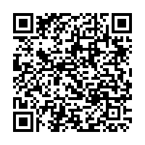
Stay in touch with us!
Office E-mail:
DenverCouncil5@denvergov.org
Office Phone Number:
720.337.5555
Visit our website at bit.ly/D5Website or scan the QR code below:
denvercouncil5
denvercouncil5
denvercouncil5
Councilwoman Amanda Sawyer ★ Denver District 5

Slide 32
Election: Candidate Introductions
Only paid members may run for a board seat
WDCA staggers elections to keep continuity
Board selects officers based on time, interests within the mix
One ballot per paid household membership given at sign in desk
Voting for three (3) open seats
Place ballots in the box marked “Vote” after candidate presentations
Ballots counted tonight by impartial residents
Visit our information tables & committee sign up sheets while waiting for the outcome!
Notes:
Candidates
Jeff Becker – a long-time resident in WD and prior board member
Jason Kunkle – a resident with an agenda of keeping our neighborhood looking good
Tim Rooney – incumbent and a past president
Any others?

Slide 33
Thank you for attending!
How to reach us
Website: www.winstondowns.org Email: info@winstondown.org

