Slide 1
East Avenues Safety Study
D5 Community Cabinet
Molly Lanphier, Community Designer

Slide 2
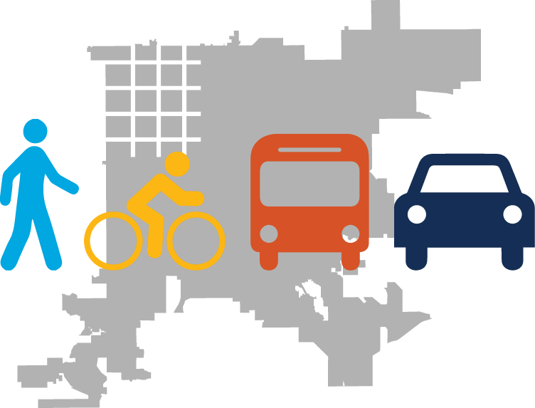
Study Boundaries
E 13th Avenue
E 14th Avenue
E 16th Avenue
East 17th Avenue
East 18th Avenue
Broadway → Yosemite St
Detroit→ Colorado Blvd
Colorado Blvd → Yosemite St
Studied through a transit Speed & Reliability Study

Slide 3
Crash History 2018-2022
1120
358

Slide 4
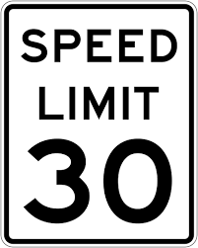
Percent of Vehicles Speeding by Street

Slide 5
Themes from Outreach

Slide 6
Speeding Proposed Solutions
Signal Coordination
Chicanes
Bulbouts
Speed Cushions

Slide 7
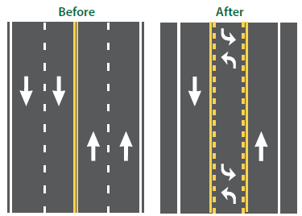
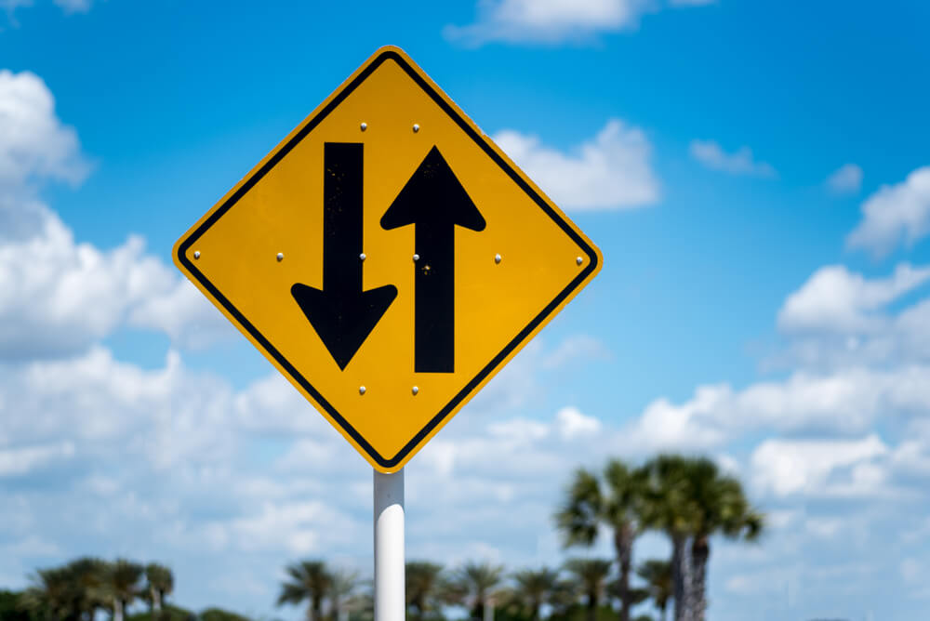
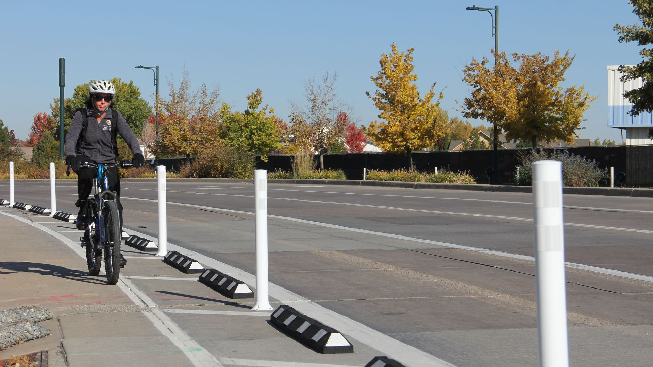
Speeding Additional Solutions
Protected
Bike Lanes
Lane Reduction
Two-Way
Conversion

Slide 8
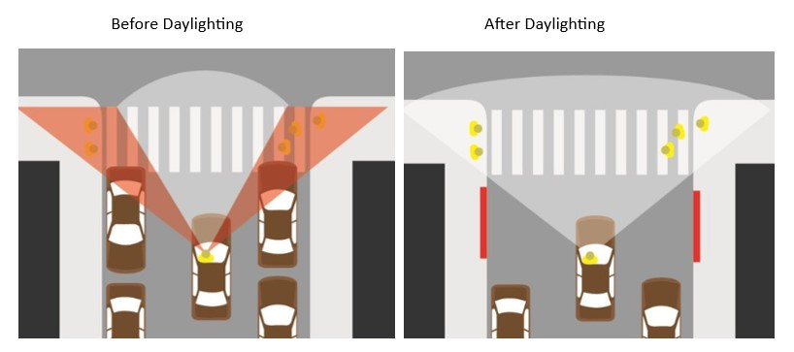
Broadside Crashes Proposed Solutions at Unsignalized Intersections
Increase Sight Distance
Daylighting- Increasing sight distance by prohibiting parking by an additional 20 feet

Slide 9
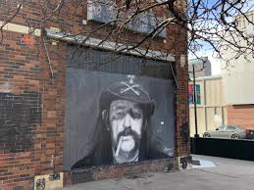
Near Term Implementation
Bulbouts
Two-Way Conversion
13th Ave & Ogden, Corona, Downing and Marion
14th Ave & Washington, Corona, Marion and Lafayette
13th & 14th from Quebec to Yosemite- Spring/ Summer 2025

Slide 10
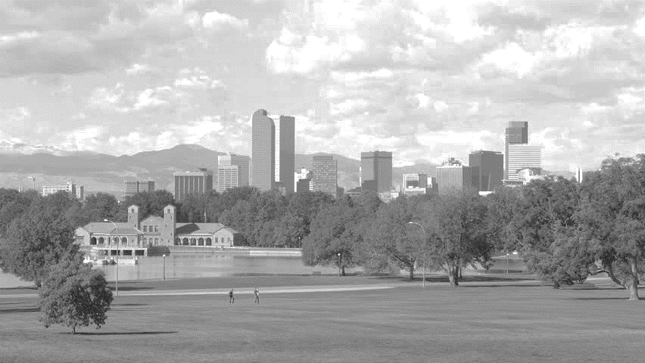
Next Steps
Study the feasibility of the longer-term solutions post BRT construction
Identify Additional Funding
Keep Collecting Data via 311 and DPD

Slide 11
Questions? Website: DenverGov.org/EastAveSafety Email: EastAveSafety@DenverGov.org
Notes:
311

